Slide 1

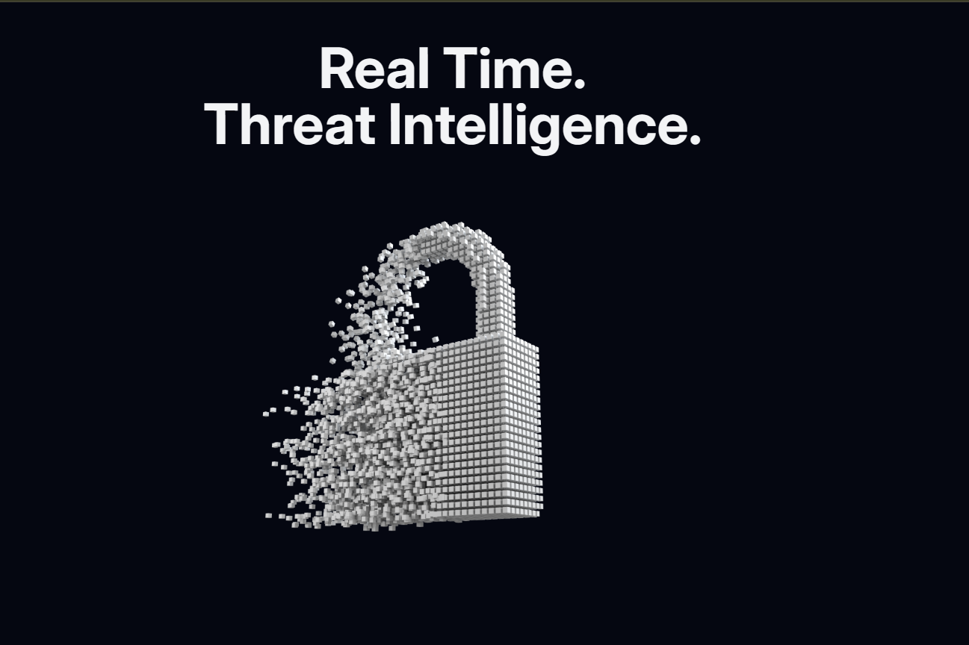




Real Time. Threat Intelligence 01

Slide 2
Introduction & Project overview
Aggregate asset & vulnerability data
Provide actionable risk insights
Enable continuous monitoring

Slide 3
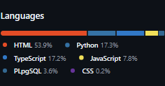
System Architecture & Technologies Used
Front-end: Next.js, Tailwind CSS, shadcn/ui, Recharts
Back-end: Next.js API routes, Node.js, PostgreSQL, Firebase
DevOps/Security: Kali Linux, gsad,

Slide 4
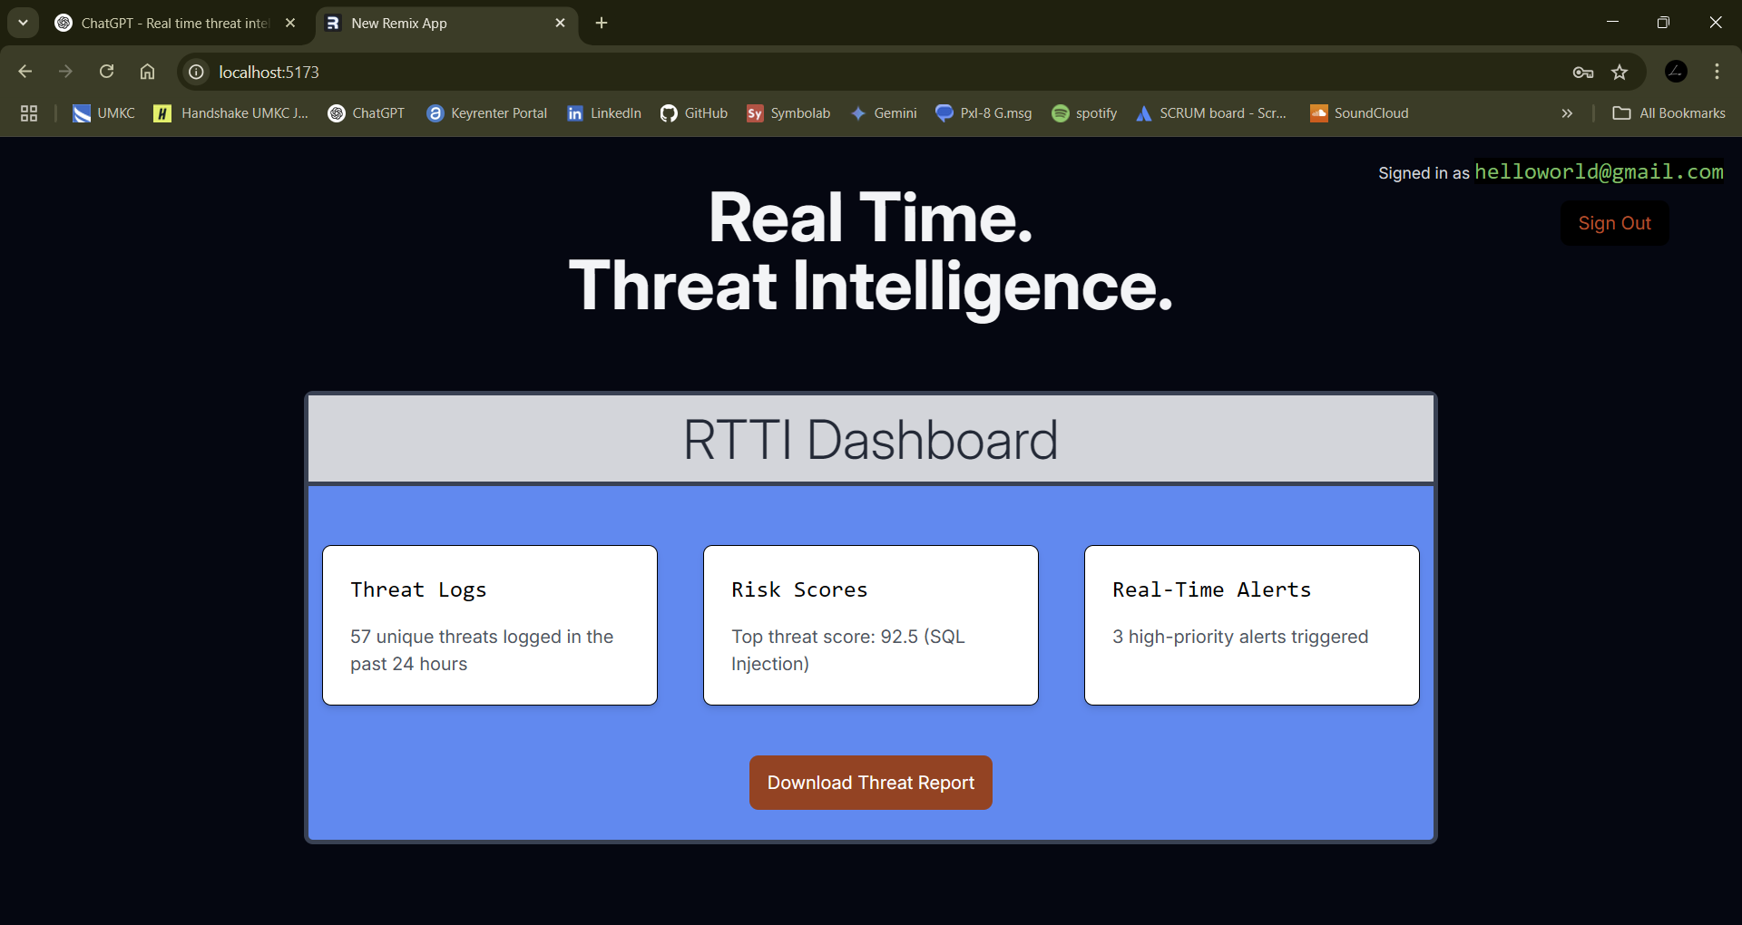
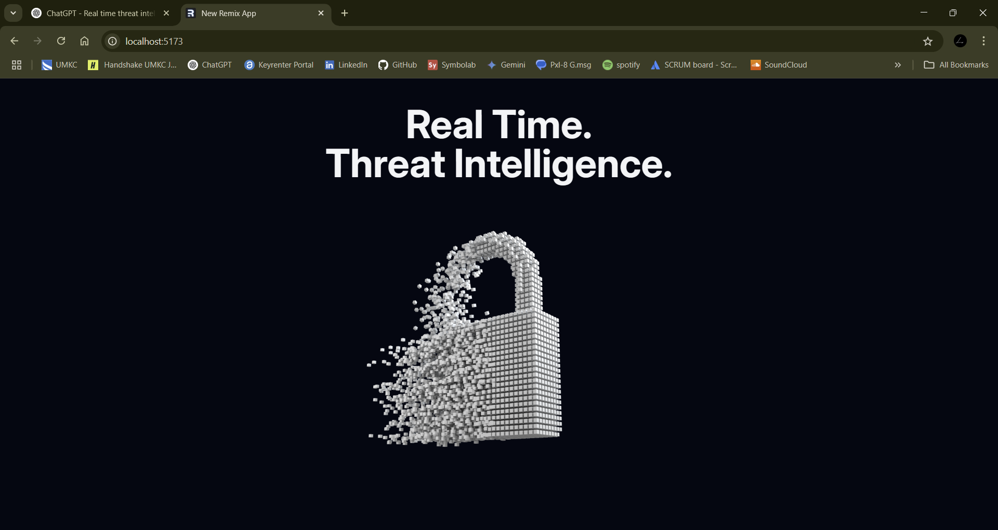
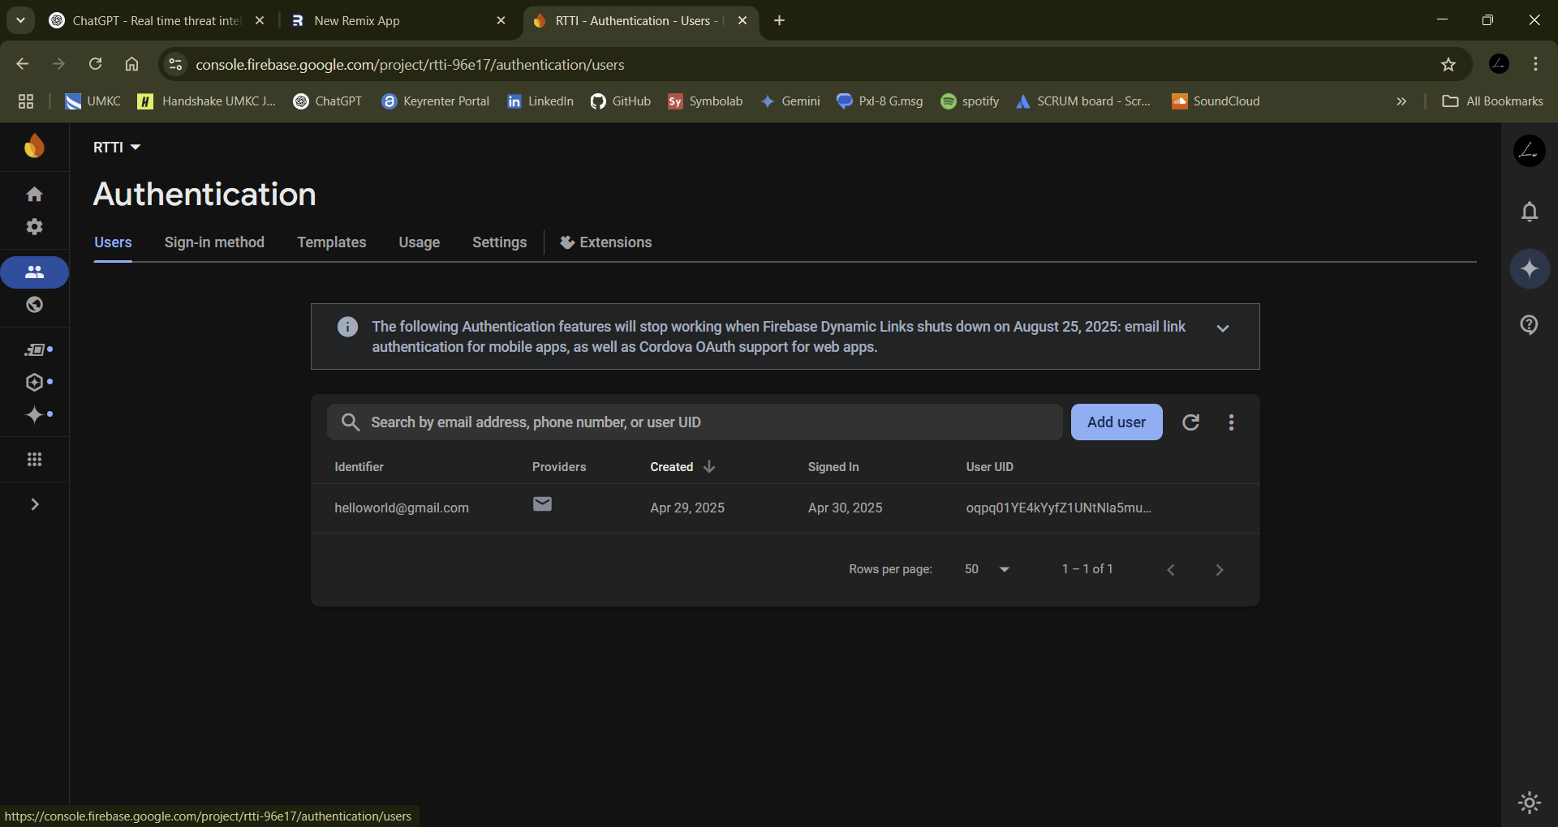
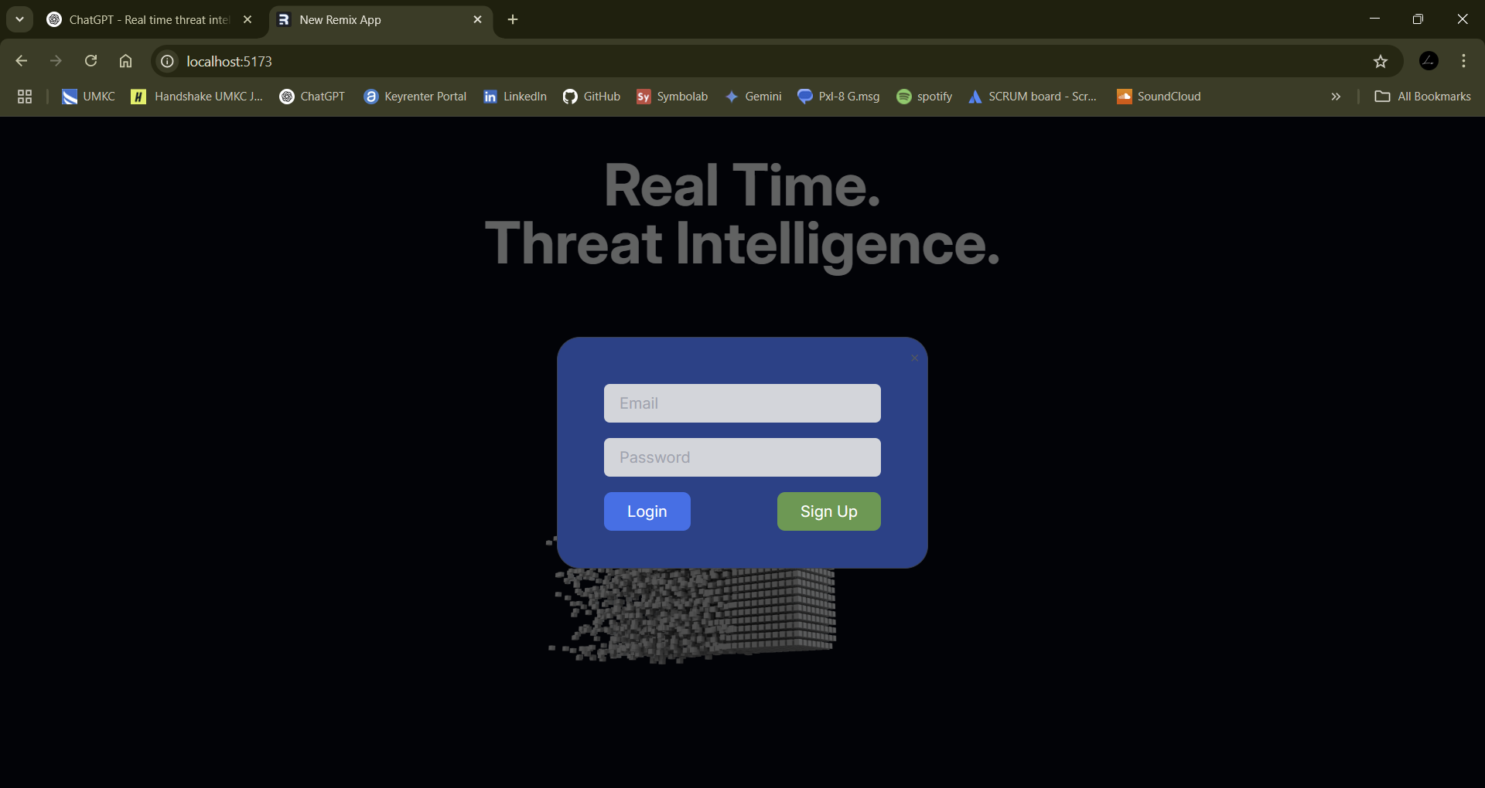
System Demo

Slide 5
Security Features & Risk Management Approach
02
Implemented defense-in-depth:
Network segmentation and VLAN configuration in Cisco Packet Tracer
DMZ setup and firewall rules on perimeter routers
Deployed Greenbone Security Assistant (gsad) for automated vulnerability scanning
Automated scheduled scans (via systemd timers) feeding results into PostgreSQL (tva_mapping)
Built a risk-scoring algorithm in SQL/Node.js to quantify severity levels (High/Medium/Low)
Integrated real-time alerting in the Next.js dashboard—red/yellow/green indicators based on hasNewMessage-style flags
Defined a threat model and classified assets by type (Hardware, Software, Data, People, Processes) to focus protection efforts.

Slide 6
Testing & Evaluation Metrics
03
Testing & Evaluation Metrics
Established coverage metrics: weekly scan percentage of total assets
Measured detection latency: time from vulnerability discovery to dashboard update (using timestamps and log analyses)
Tracked false-positive rates by deduplicating noisy GSAD findings in a nightly cleanup job
Conducted load testing on API routes with Artillery to ensure sub-200 ms response times under 100 concurrent users
Wrote unit & integration tests (Jest + React Testing Library) for both Next.js API endpoints and React components
Monitored performance metrics in console logs and lightweight Prometheus/Grafana setup for key endpoints

Slide 7
Challenges & Solutions
Data inconsistency across scan formats → wrote an ETL script in Node.js to normalize fields before insertion
Real-time updates causing UI jank → switched from naive setInterval polling to SWR with incremental stale-while-revalidate
API auth failures in Next.js export mode → adjusted dynamic = "force-static" and revalidate settings in next.config.ts
Chart rendering slowness with large datasets → implemented virtualization and memoization in Recharts components
Responsive layout issues on Android Expo build → constrained Video layer’s z-index and set overflow: hidden on parent view

Slide 8
Future Improvements:
Automated remediation: integrate with a ticketing/orchestration tool (e.g., Jira or Ansible) to auto-open fix tickets for critical findings
Machine-learning risk prediction: leverage historical scan data to forecast emerging high-risk assets
Role-based access control: add RBAC to the dashboard for multi-user environments with audit logging
SIEM integration: forward key events and alerts to a centralized SIEM (e.g., Splunk or ELK) for long-term correlation
User-customizable dashboards: allow filtering, custom KPIs, and saved views per stakeholder preferences

Slide 9
What next?
Present the timeline.
Solicit comments on these slides or reviews on these wireframes in the Balsamiq add-on.
User testing plan.

Slide 10
Questions?

